Slide 1
Arc-length computation and arc-length parameterization

Slide 2
Arc-length computation
Parametric spatial curve used to define the route of an object
    Q(t)=(x(t),y(t),z(t))
Arc-length computation necessary for motion control along a curve
  Control the speed at which the curve is traced
Two problems
  Parameter t ->arc length s, s=A(t)
  Arc length s ->parameter t, t=A⁻¹(s)

Slide 3
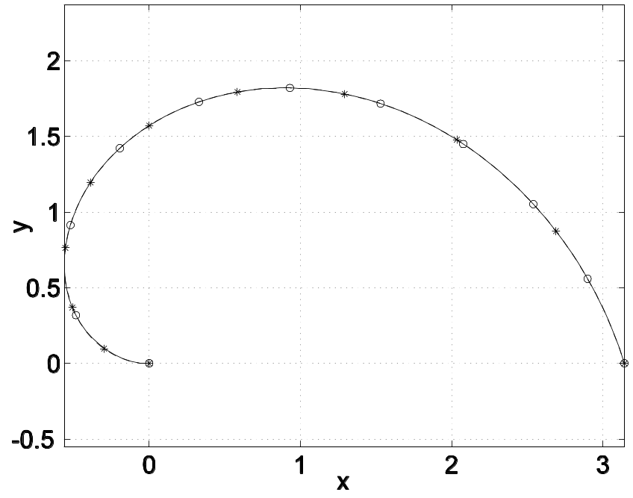
Relationship between arc length and parameter
In general, t and s are not linearly related

Slide 4
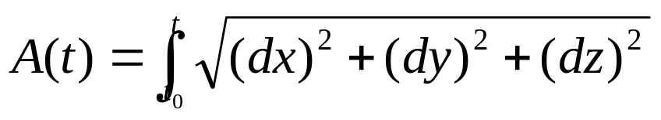
Analytic approach to computing arc length
Arc length is a geometric integration
In general, this integral doesn’t integrate
Solution: Numeric approaches

Slide 5
Numerical approaches for arc-length computation
Divide the range [t₀,t] into intervals
Compute arc length within each interval
  Gaussian quadrature
  Simpson’s rule
  …
Arc length within range [t₀,t] computed as the sum of arc length within each interval

Slide 6
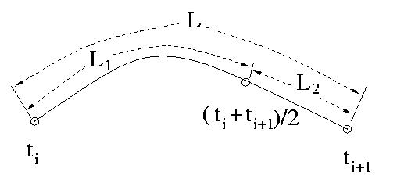
Control accuracy of arc length computation
Adaptive method to compute arc length within one interval
  Compute arc length within the whole interval, L
  Divide the interval into two halves
  Compute arc length within each sub interval, L₁,L₂
  Error is estimated as L – (L₁+L₂)
    Stop, if error is within required accuracy, otherwise,
    Repeat above steps for each sub interval

Slide 7
Accelerate arc-length computation
Build a table
  Divide the parameter range into intervals
  Compute arc length within each interval
  Build a table of correspondence between parameter and arc length
Map parameter to arc length
  Map parameter to an interval
  Find arc-length value before this interval from the table
  Compute the arc length within part of the interval

Slide 8
Traditional approach of arc-length parameterization for parametric curves
Compute arc length s as a function of parameter t
  s=A(t)
Compute the inverse of the arc-length function
  t=A⁻¹(s)
Replace parameter t in Q(t)=(x(t),y(t),z(t)) with A⁻¹(s)

Slide 9
Numerical arc-length parameterization (cont.)
Bisection method to compute t=A⁻¹(s)
  Table search to locate an interval [t_{i}, t_{i+1}] ,
  A(t_{i} ) ≤ s < A(t_{i+1} )
  Use [t_{i}, t_{i+1}] as the start interval
  Each iteration an arclength integration evaluated
  Advantage: solution guaranteed
  Problem: slow and lots of computations

Slide 10

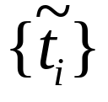
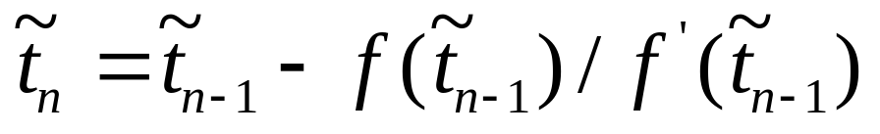
Numerical arc-length parameterization (cont.)
Newton-Raphson method to compute t=A⁻¹(s)
  Seen as root finding problem of the equation,
  f(t)=s-A(t)=0
  Table search to locate an interval
  Linear interpolation within the interval to compute
  Compute sequence of ,

Slide 11
Numerical arc-length parameterization (cont.)
Advantage of Newton-Raphson method
  May faster than bisection method, although no guarantee
Problems:
  Each iteration an arc-length integration evaluated
  T_{i} may lie outside the definition of the space curve
  no guarantee of convergence

Slide 12
Use explicit function to approximate arc-length parameterization
Functions relate arc-length s and parameter t
  s strictly monotonically increasing with t
    A curve describes how s varies with t, s=A(t)
  t strictly monotonically increasing with s
    A curve describes how t varies with s, t=A⁻¹(s)
  Bezier curves are an option

Slide 13
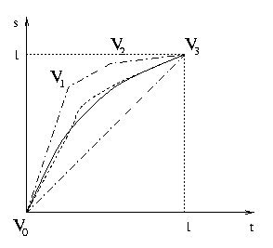
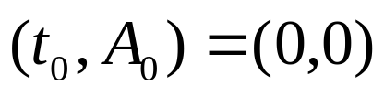
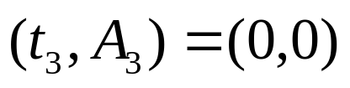
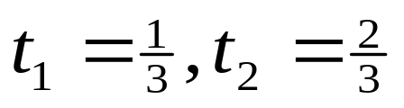


Use explicit function to approximate arc-length parameterization (Cont.)
The four control points of a Bezier curve
  ,
  By linear precision property,
  A(1/3) & A(2/3) computed from original curve
  Solve & from 2 equations

Slide 14
Use explicit function to approximate arcle-ngth parameterization (Cont.)
Two-span Bezier curve
  Two-span Bezier curve used when A(t) has more than one inflexion points
  If A(t) has 2 inflexion point t₁ and t₂, the break point of the two spans is in (t₁ +t₂)/2
  If A(t) has 3 inflexion point t_{1,} ,t₂ and t₃ , the break point of the two spans is t₂

Slide 15
Use explicit function to approximate arc-length parameterization (Cont.)
Advantages
  Fast function evaluations
  Constant time to compute t from s
  Constant time to compute s from t
Disadvantages
  Error out of control
  Numerical root finding to locate inflexion points
  No guarantee of monotonicity

Slide 16
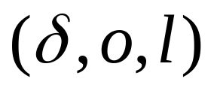



Arc-length parameterization in Hank
Roads modeled as ribbons with centerline modeled as cubic spline Q(t)
Curvilinear coordinates
  ,distance on centerline from start point
  ,offset from centerline
  ,loft from road surface
Mapping between and (x,y,z) in real time

Slide 17
Approximately arc-length parameterized cubic spline curve
Compute curve length
Find m+1 equally spaced points on input curve
Interpolate (x,y,z) to arc length s to get a new cubic spline curve

Slide 18
Compute arc length and build a mapping table
Compute arc length of a cubic spline piece with Simpson’s rule
  Adaptive methods can be used to control the accuracy of arc length computation
Lengths of all spline pieces are summed
Build a table for mappings between parameter and arc length on knot points

Slide 19
Find m+1equally spaced points
Problem
  Mappings from equally spaced arc-length values 0, 1L/m, 2L/m, …, mL/m to parameter values
Solution:
  Table search to map an arc-length value to a parameter interval
  Bisection method to map the arc-length value to a parameter value within the parameter interval

Slide 20
Compute an approximate arc-length parameterized spline curve
m+1 points as knot points
Arc length as parameter
Using cubic spline interpolation
  End point derivative conditions, or,
  Not-a-knot conditions
Endpoint derivative conditions
  Direction of tangent vector on end points consistent with the input curve
  Magnitude of tangent vector on end points is 1.0

Slide 21
Errors
Match error
  Misfit of the derived curve from an input curve
Arc-length parameterization error
  deviation of the derived curve from arc-length parameterization

Slide 22
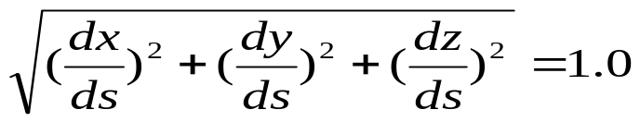
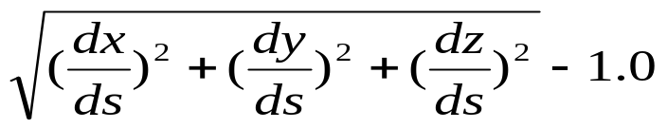
Errors analysis
Match error
  Traverse the derived curve and input curve
  Match error is the difference between two curves at corresponding points, |Q(t)-P(s)|
Arc-length parameterization error
  For an arc-length parameterized curve,
  Arc-length parameterization error measured by

Slide 23
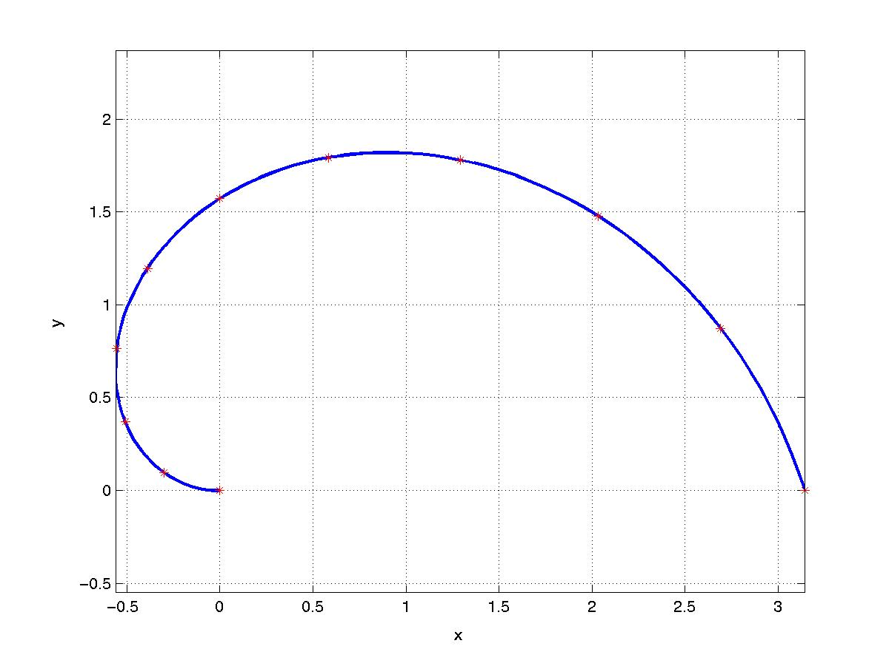
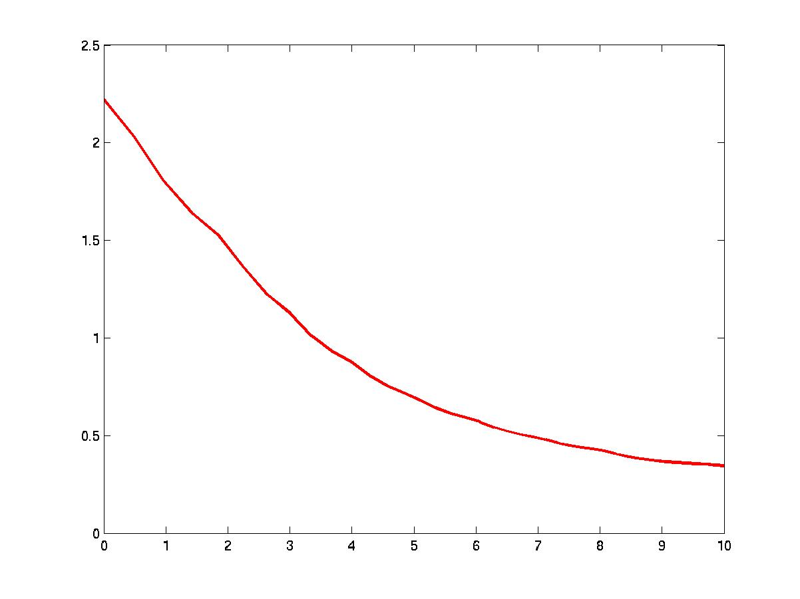
Experimental results
(1) Experimental curve (2) Curvature of the curve

Slide 24
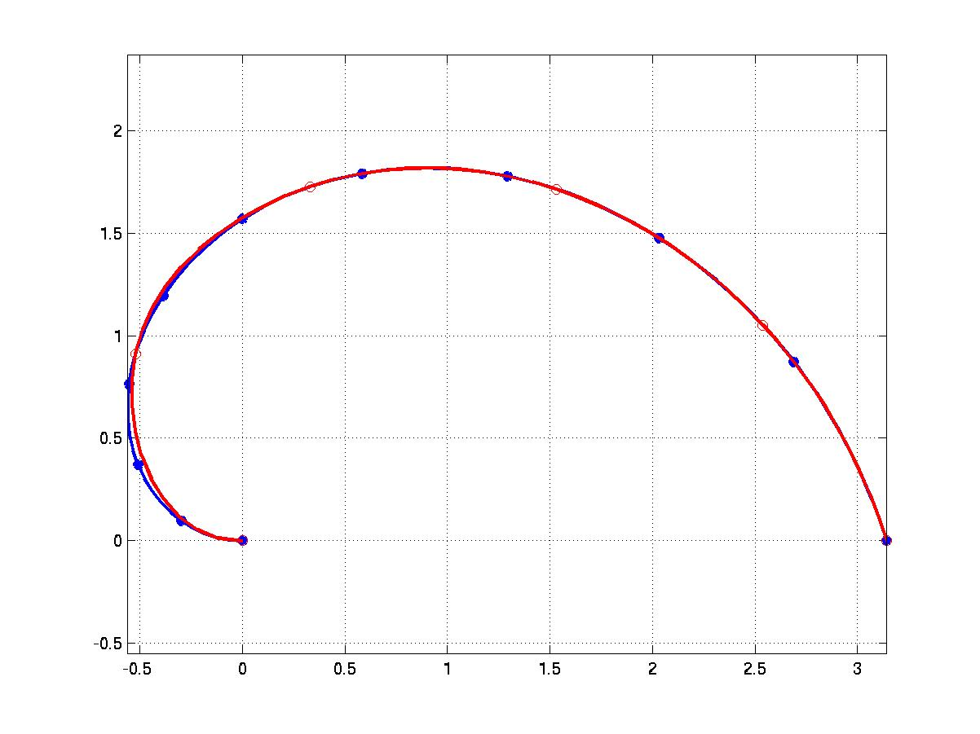
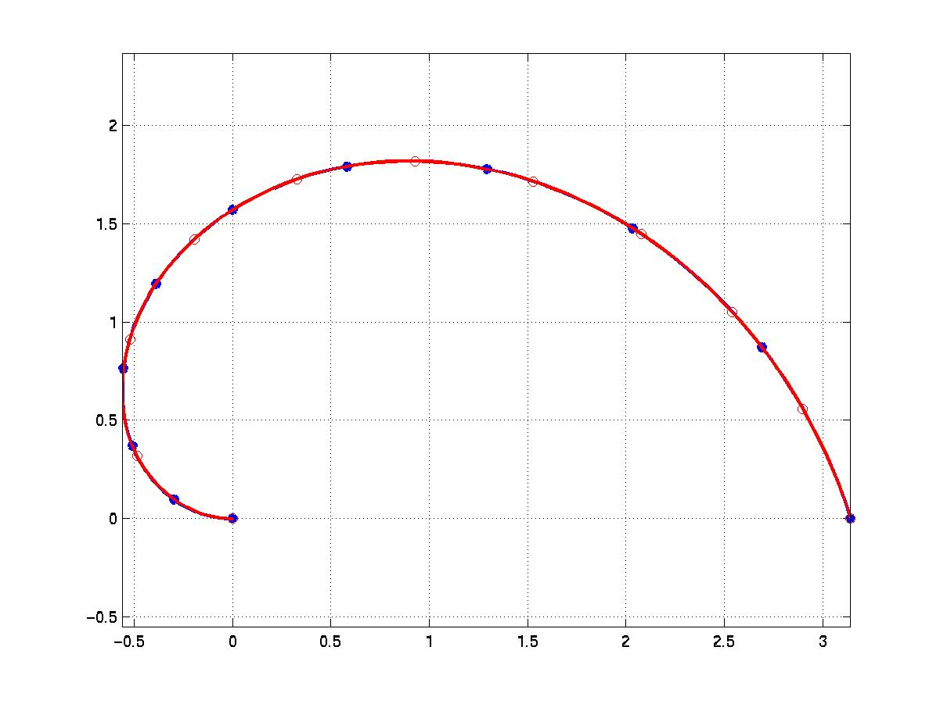
Experimental results (cont.)
(1) m=5 (2) m=10
Experimental curve(blue) and the derived curve (red) with their knot points

Slide 25
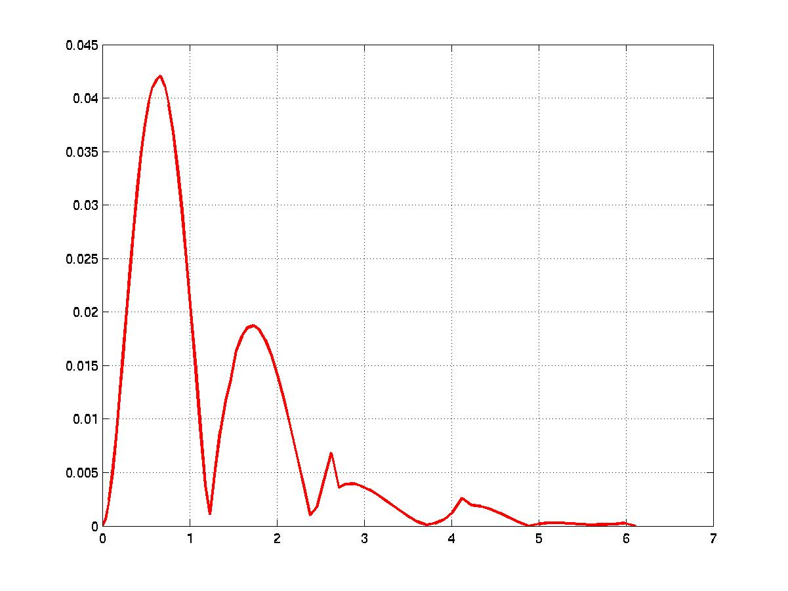
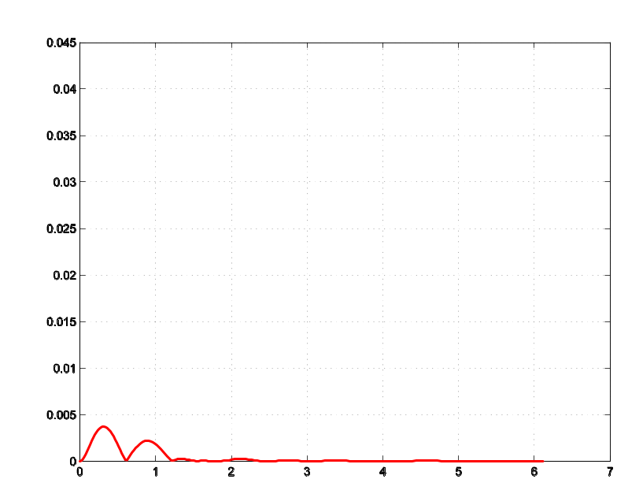
Experimental results (cont.)
(1) m=5 (2) m=10
Match error of the derived curve

Slide 26
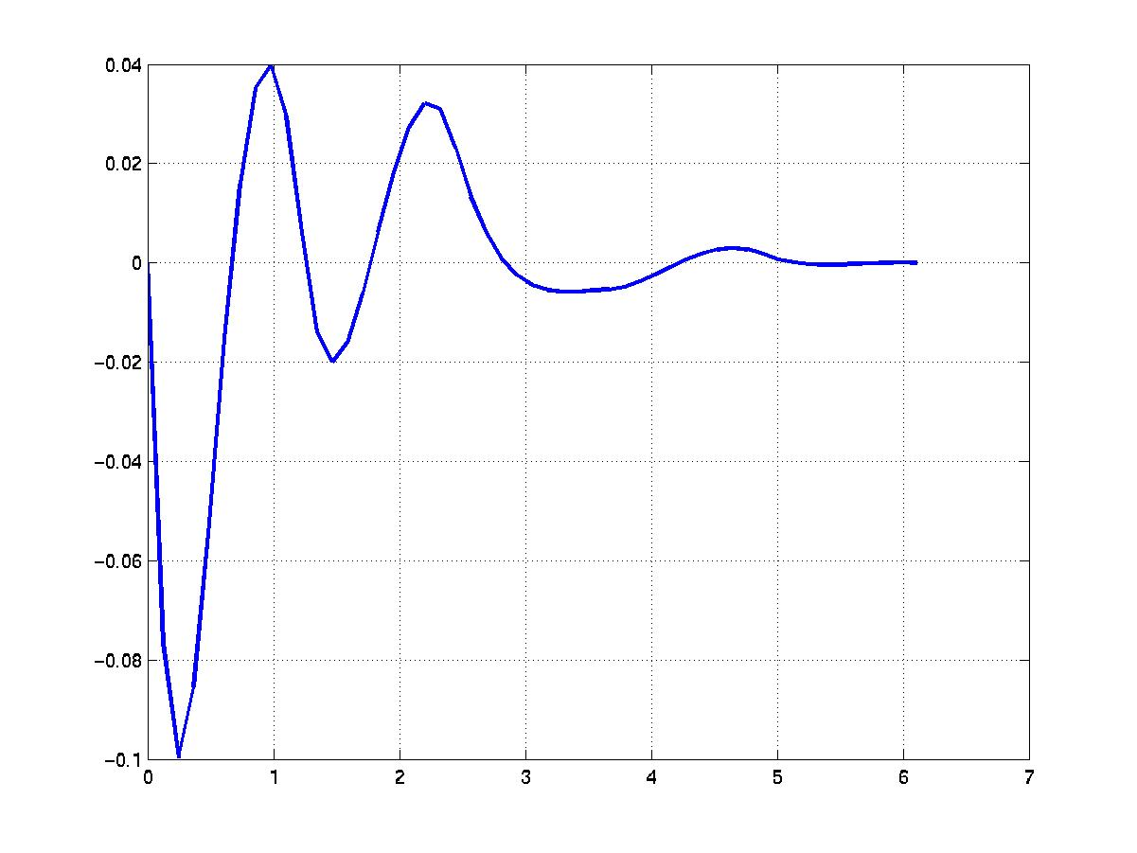
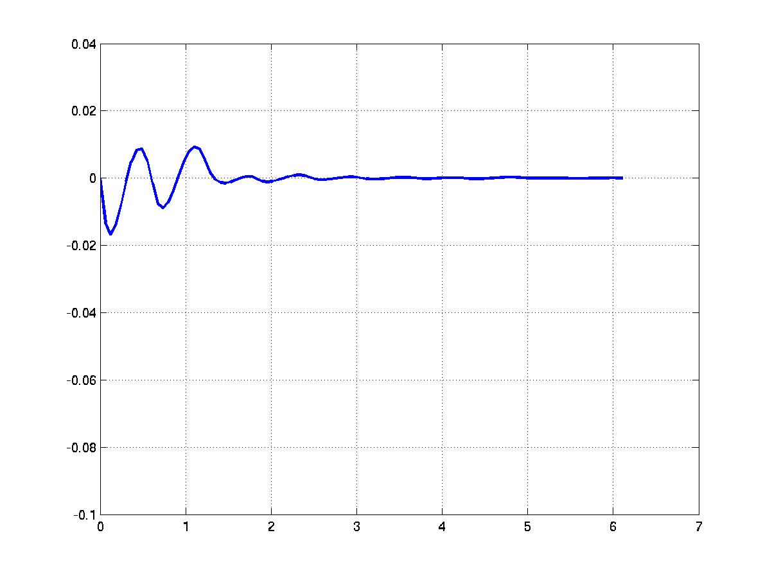
Experimental results (cont.)
(1) m=5 (2) m=10
Arc-length parameterization error of the derived curve

Slide 27
Error factors in experimental results
Both errors increase with curvature
Both errors decrease with m
  Maximal match error decreases 10 times when m doubled
  Maximal arc-length parameterization error decreases 5 times when m doubled

Slide 28
Strengths of this technique
Run-time efficiency is high
  No mapping between parameter and arc-length needed
  No table search needed for mapping from curvilinear coordinates to Cartesian coordinates
  Mapping form Cartesian coordinates to curvilinear coordinates is efficient (introduced in another paper)
Time-consuming computations can be put either in initialization period or off-line

Slide 29
Strengths of this technique (cont.)
Higher accuracy can be achieved
  By computing length of the input curve more accurately
  By locating equal-spaced points more accurately
  By increasing m
Burden of higher accuracy is only more memory
  Doubling m requires doubling the memory for spline curve coefficients

